Slide 1
Global Development Cluster Analysis
Clustering countries based on real world features
By Group 6

Slide 2
OBJECTIVE
Cluster countries based on real-world socio-economic and development indicators
Identify patterns and similarities between nations using machine learning
Generate data-driven insights to understand global development levels

Slide 3
Expected Outcomes
Countries grouped into distinct clusters based on development metrics
Clear identification of similarities and differences between nations
Actionable insights for comparison and future research
Strong foundation for visualization and decision-making

Slide 4
Dataset overview
Countries grouped into distinct clusters based on development metrics
Birth Rate | Business Tax Rate | CO2 Emissions | Country | Days to Start Business | Ease of Business | Energy Usage | GDP | Health Exp % GDP | Health Exp/Capita | Hours to do Tax | Infant Mortality Rate | Internet Usage | Lending Interest | Life Expectancy Female | Life Expectancy Male | Mobile Phone Usage | Number of Records | Population 0-14 | Population 15-64 | Population 65+ | Population Total | Population Urban | Tourism Inbound | Tourism Outbound
0.02 |  | 87931 | Algeria |  |  | 26998 | $54,790,058,957 | 0.035 | $60 |  | 0.034 | 0 | 0.1 | 71 | 67 | 0 | 1 | 0.342 | 0.619 | 0.039 | 31719449 | 0.599 | $102,000,000 | $193,000,000
0.05 |  | 9542 | Angola |  |  | 7499 | $9,129,594,819 | 0.034 | $22 |  | 0.128 | 0 | 1.032 | 47 | 44 | 0 | 1 | 0.476 | 0.499 | 0.025 | 13924930 | 0.324 | $34,000,000 | $146,000,000
0.043 |  | 1617 | Benin |  |  | 1983 | $2,359,122,303 | 0.043 | $15 |  | 0.09 | 0 |  | 57 | 53 | 0 | 1 | 0.454 | 0.517 | 0.029 | 6949366 | 0.383 | $77,000,000 | $50,000,000
0.027 |  | 4276 | Botswana |  |  | 1836 | $5,788,311,645 | 0.047 | $152 |  | 0.054 | 0 | 0.155 | 52 | 49 | 0.1 | 1 | 0.383 | 0.587 | 0.029 | 1755375 | 0.532 | $227,000,000 | $209,000,000
0.046 |  | 1041 | Burkina Faso |  |  |  | $2,610,959,139 | 0.051 | $12 |  | 0.096 | 0 |  | 52 | 49 | 0 | 1 | 0.468 | 0.505 | 0.028 | 11607944 | 0.178 | $23,000,000 | $30,000,000
0.042 |  | 301 | Burundi |  |  |  | $870,486,066 | 0.063 | $7 |  | 0.092 | 0 | 0.158 | 49 | 47 | 0 | 1 | 0.49 | 0.481 | 0.029 | 6674286 | 0.082 | $1,400,000 | $14,000,000
0.041 |  | 3432 | Cameroon |  |  | 6310 | $9,287,367,569 | 0.044 | $26 |  | 0.093 | 0 | 0.22 | 53 | 51 | 0 | 1 | 0.453 | 0.513 | 0.034 | 15927713 | 0.455 | $132,000,000 | $241,000,000
0.039 |  | 268 | Central African Republic |  |  |  | $914,500,332 | 0.043 | $11 |  | 0.113 | 0 | 0.22 | 45 | 42 | 0 | 1 | 0.423 | 0.537 | 0.04 | 3638316 | 0.376 | $5,000,000 | $33,000,000
0.051 |  | 176 | Chad |  |  |  | $1,385,058,212 | 0.063 | $10 |  | 0.106 | 0 | 0.22 | 48 | 46 | 0 | 1 | 0.49 | 0.482 | 0.028 | 8301151 | 0.216 | $14,000,000 | $56,000,000
0.039 |  | 84 | Comoros |  |  |  | $201,899,884 | 0.035 | $13 |  | 0.073 | 0 | 0.12 | 59 | 56 |  | 1 | 0.415 | 0.554 | 0.031 | 528312 | 0.281 | $15,000,000
0.048 |  | 1646 | Congo, Dem. Rep. |  |  | 16679 | $19,088,046,305 | 0.048 | $14 |  | 0.115 | 0 |  | 48 | 45 | 0 | 1 | 0.464 | 0.507 | 0.028 | 46949244 | 0.351
0.039 |  | 1049 | Congo, Rep. |  |  | 814 | $3,219,910,666 | 0.021 | $22 |  | 0.077 | 0 | 0.22 | 53 | 51 | 0 | 1 | 0.419 | 0.545 | 0.036 | 3126204 | 0.587 | $12,400,000 | $59,000,000
0.038 |  | 6791 | Cote d'Ivoire |  |  | 6734 | $10,417,060,605 | 0.065 | $42 |  | 0.1 | 0 |  | 47 | 46 | 0 | 1 | 0.421 | 0.55 | 0.029 | 16131332 | 0.435 | $53,000,000 | $291,000,000
0.03 |  | 403 | Djibouti |  |  |  | $551,230,862 | 0.058 | $44 |  | 0.08 | 0 |  | 59 | 55 | 0 | 1 | 0.414 | 0.556 | 0.03 | 722887 | 0.765 | $8,100,000 | $14,800,000
Global development measurement dataset containing multiple countries across the world
Includes important socio-economic and development indicators
Variables include: GDP, CO₂ emissions, birth rate, life expectancy, health expenditure, internet usage, business tax rate, infant mortality, lending rate, etc.
Suitable for clustering analysis using machine learning

Slide 5
DATA PREPROCESSING
Birth Rate | CO2 Emissions | Country | Energy Usage | GDP | Health Exp % GDP | Health Exp/Capita | Infant Mortality Rate | Internet Usage | Lending Interest | Life Expectancy Female | Life Expectancy Male | Mobile Phone Usage | Population 0-14 | Population 15-64 | Population 65+ | Population Total | Population Urban | Tourism Inbound | Tourism Outbound
0.02 | 87931 | Algeria | 26998 | 5.48E+10 | 0.035 | 60 | 0.034 | 0 | 0.1 | 71 | 67 | 0 | 0.342 | 0.619 | 0.039 | 31719449 | 0.599 | 1.02E+08 | 1.93E+08
0.05 | 9542 | Angola | 7499 | 9.13E+09 | 0.034 | 22 | 0.128 | 0 | 1.032 | 47 | 44 | 0 | 0.476 | 0.499 | 0.025 | 13924930 | 0.324 | 34000000 | 1.46E+08
0.043 | 1617 | Benin | 1983 | 2.36E+09 | 0.043 | 15 | 0.09 | 0 | 0.12 | 57 | 53 | 0 | 0.454 | 0.517 | 0.029 | 6949366 | 0.383 | 77000000 | 50000000
0.027 | 4276 | Botswana | 1836 | 5.79E+09 | 0.047 | 152 | 0.054 | 0 | 0.155 | 52 | 49 | 0.1 | 0.383 | 0.587 | 0.029 | 1755375 | 0.532 | 2.27E+08 | 2.09E+08
0.046 | 1041 | Burkina Faso | 14338 | 2.61E+09 | 0.051 | 12 | 0.096 | 0 | 0.12 | 52 | 49 | 0 | 0.468 | 0.505 | 0.028 | 11607944 | 0.178 | 23000000 | 30000000
0.042 | 301 | Burundi | 14338 | 8.7E+08 | 0.063 | 7 | 0.092 | 0 | 0.158 | 49 | 47 | 0 | 0.49 | 0.481 | 0.029 | 6674286 | 0.082 | 1400000 | 14000000
0.041 | 3432 | Cameroon | 6310 | 9.29E+09 | 0.044 | 26 | 0.093 | 0 | 0.22 | 53 | 51 | 0 | 0.453 | 0.513 | 0.034 | 15927713 | 0.455 | 1.32E+08 | 2.41E+08
0.039 | 268 | Central African Republic | 14338 | 9.15E+08 | 0.043 | 11 | 0.113 | 0 | 0.22 | 45 | 42 | 0 | 0.423 | 0.537 | 0.04 | 3638316 | 0.376 | 5000000 | 33000000
0.051 | 176 | Chad | 14338 | 1.39E+09 | 0.063 | 10 | 0.106 | 0 | 0.22 | 48 | 46 | 0 | 0.49 | 0.482 | 0.028 | 8301151 | 0.216 | 14000000 | 56000000
0.039 | 84 | Comoros | 14338 | 2.02E+08 | 0.035 | 13 | 0.073 | 0 | 0.12 | 59 | 56 | 0.5 | 0.415 | 0.554 | 0.031 | 528312 | 0.281 | 15000000 | 4.56E+08
0.048 | 1646 | Congo, Dem. Rep. | 16679 | 1.91E+10 | 0.048 | 14 | 0.115 | 0 | 0.12 | 48 | 45 | 0 | 0.464 | 0.507 | 0.028 | 46949244 | 0.351 | 6.89E+08 | 4.56E+08
0.039 | 1049 | Congo, Rep. | 814 | 3.22E+09 | 0.021 | 22 | 0.077 | 0 | 0.22 | 53 | 51 | 0 | 0.419 | 0.545 | 0.036 | 3126204 | 0.587 | 12400000 | 59000000
0.038 | 6791 | Cote d'Ivoire | 6734 | 1.04E+10 | 0.065 | 42 | 0.1 | 0 | 0.12 | 47 | 46 | 0 | 0.421 | 0.55 | 0.029 | 16131332 | 0.435 | 53000000 | 2.91E+08
0.03 | 403 | Djibouti | 14338 | 5.51E+08 | 0.058 | 44 | 0.08 | 0 | 0.12 | 59 | 55 | 0 | 0.414 | 0.556 | 0.03 | 722887 | 0.765 | 8100000 | 14800000
0.025 | 141326 | Egypt, Arab Rep. | 40658 | 9.98E+10 | 0.054 | 79 | 0.036 | 0 | 0.132 | 71 | 66 | 0 | 0.354 | 0.592 | 0.053 | 66136590 | 0.428 | 4.66E+09 | 1.21E+09
0.04 | 455 | Equatorial Guinea | 14338 | 1.05E+09 | 0.024 | 57 | 0.099 | 0 | 0.22 | 49 | 46 | 0 | 0.426 | 0.537 | 0.037 | 518179 | 0.388 | 5000000 | 19000000
0.04 | 609 | Eritrea | 708 | 7.06E+08 | 0.045 | 7 | 0.058 | 0 | 0.12 | 58 | 54 | 0.5 | 0.47 | 0.512 | 0.018 | 3939348 | 0.176 | 36000000 | 4.56E+08
0.044 | 5831 | Ethiopia | 25242 | 8.09E+09 | 0.043 | 5 | 0.09 | 0 | 0.109 | 53 | 51 | 0 | 0.466 | 0.503 | 0.031 | 66024199 | 0.147 | 2.05E+08 | 80000000
0.034 | 1052 | Gabon | 1463 | 5.07E+09 | 0.029 | 118 | 0.056 | 0 | 0.22 | 61 | 59 | 0.1 | 0.406 | 0.535 | 0.059 | 1225527 | 0.801 | 99000000 | 1.83E+08
Cleaned money-related columns by removing $ signs and commas
Converted multiple columns into numeric data types
Dropped features with large missing values and low relevance
Filled numeric missing data using median values
Cleaned dataset is saved for clustering

Slide 6
Clustering models used
Countries grouped into distinct clusters based on development metrics
DATA VERSIONS
Raw cleaned dataset
Averaged country dataset
APPLIED MODELS
K-Means
Agglomerative Clustering
DBSCAN
Bisecting K-Means
Gaussian Mixture Model

Slide 7
EVALUATION METRICS used
Countries grouped into distinct clusters based on development metrics
METRICS
Silhouette Score
Davies-Bouldin Index
PURPOSE
Evaluate separation & compactness of clusters

Slide 8
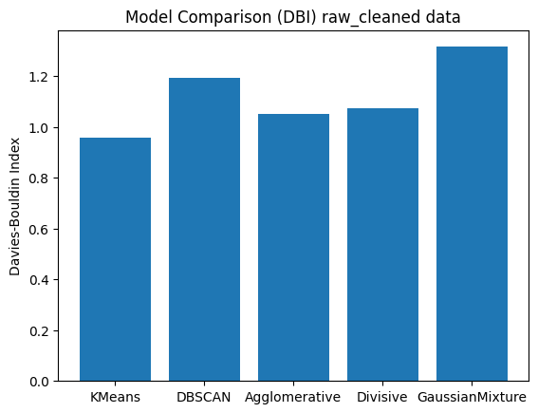
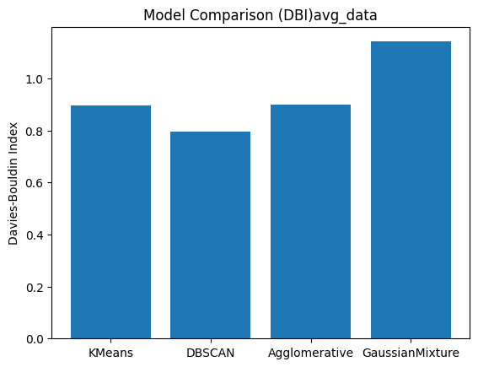
MODEL PERFORMANCE RESULTS
Countries grouped into distinct clusters based on development metrics
RAW DATA RESULTS
K-Means: Sil = 0.352, DBI = 0.958
Agglomerative: Sil = 0.338, DBI = 1.053
AVERAGED DATA RESULTS
K-Means: Sil = 0.364, DBI = 0.896
Agglomerative: Sil = 0.360, DBI = 0.901
BEST MODEL
K-Means (Avg_dataset)

Slide 9
SELECTED MODEL: K-MEANS
K-MEANS on Avg dataset
Best separation and compactness
Best Silhouette score : 0.3638292589777375
Best DBI score : 0.8957813458448394
Stable across datasets

Slide 10
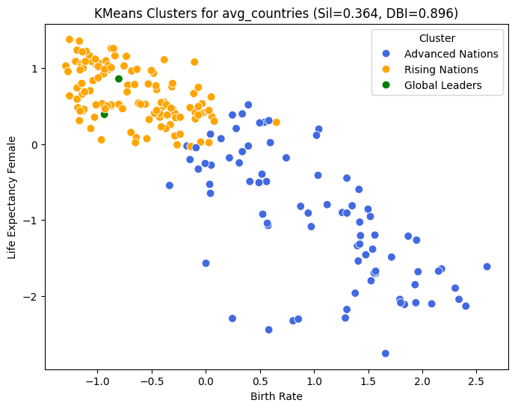
FINAL CLUSTER INSIGHTS
CLUSTER LABELS
Rising Nations
Advanced Nations
Global Leaders
OBSERVATION
Clear separation based on health, income & growth indicators

Slide 11
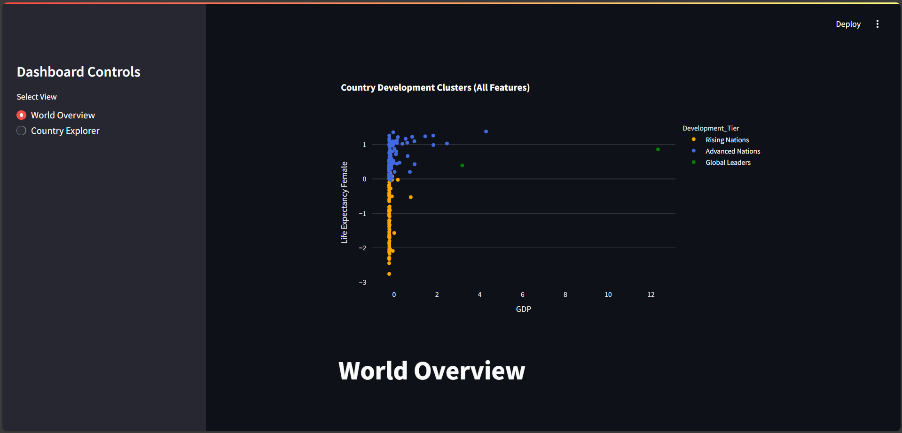
STREAMLIT DASHBOARD
DASHBOARD FEATURES
Interactive country selection
Cluster-based color grouping
Charts and metric comparisons
Real-time cluster output display
BENEFITS
Easy to explore results visually
User-friendly interface
Supports analysis for non-technical users
TOOLS USED
Python
Streamlit
K-Means Model
Click here to view the dashboard

Slide 12
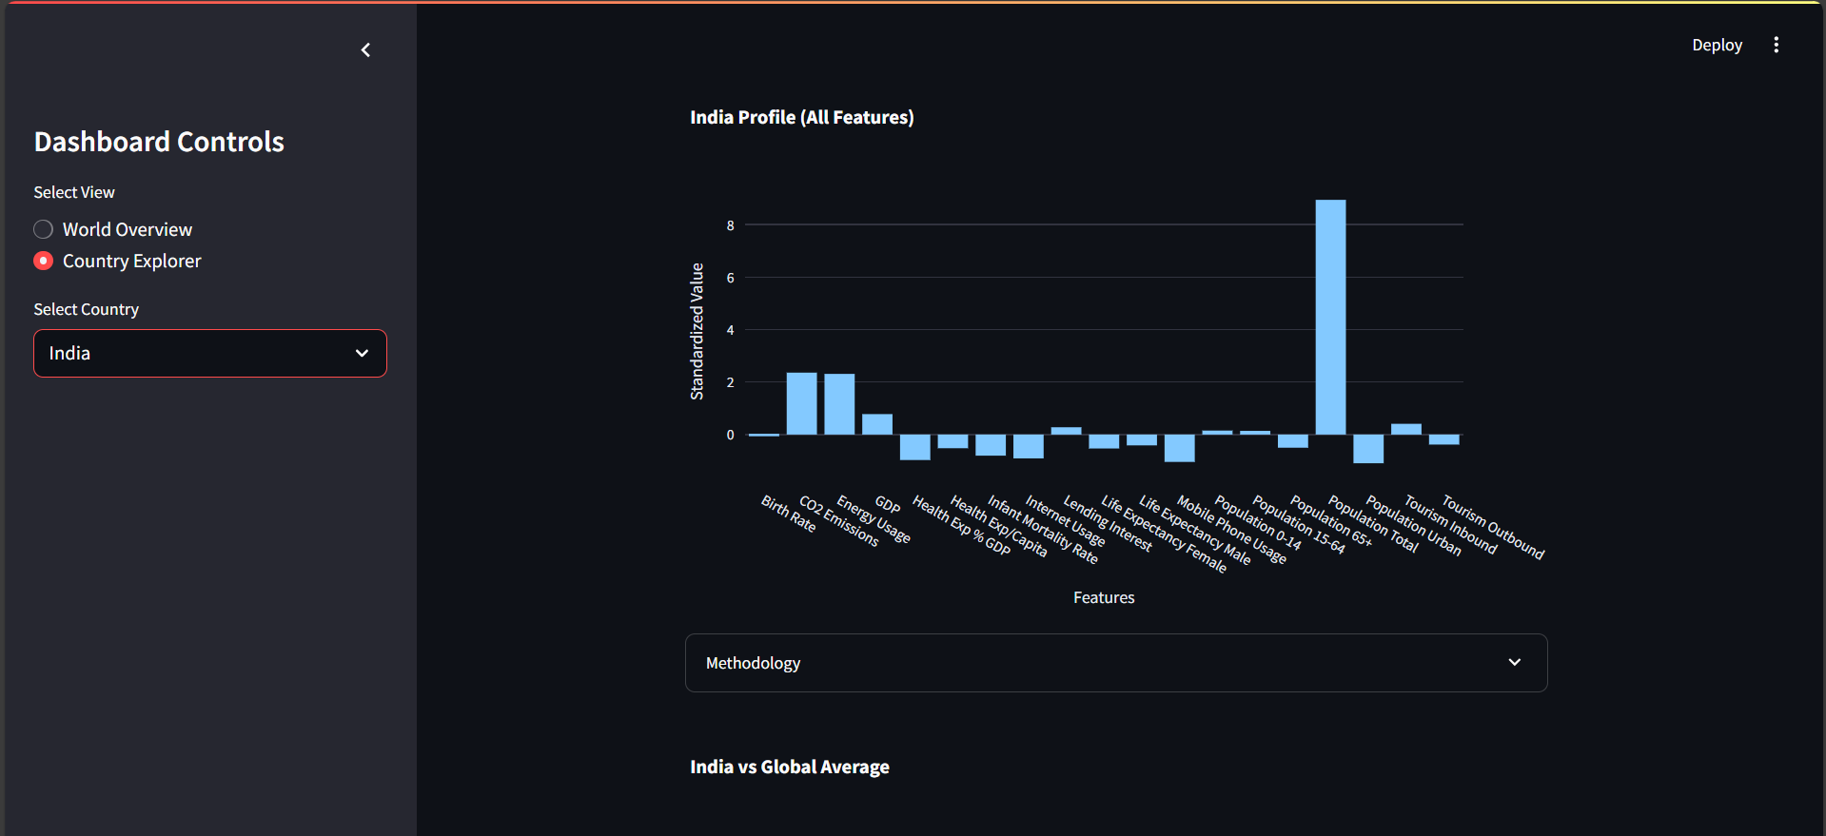
COUNTRY EXPLORER VIEW
WHAT IT SHOWS
Country-specific feature distribution
Standardized values across all indicators
Visual comparison against global patterns
INSIGHT
Helps identify strengths and weaknesses for a selected country
Supports interpretation beyond raw numbers

Slide 13
KEY FINDINGS / INSIGHTS
Countries grouped into distinct clusters based on development metrics
DEVELOPMENT PATTERNS
Clear separation between Rising, Advanced, and Global Leader nations
Rising Nations show higher birth rates and lower life expectancy values
Advanced Nations cluster around strong GDP and health outcomes
Global Leaders (very few countries) show extreme values in GDP and life expectancy
MODEL PERFORMANCE
K-Means consistently produced best Silhouette & DBI scores
Agglomerative supported similar grouping → confirms cluster stability

Slide 14
LIMITATIONS
Countries grouped into distinct clusters based on development metrics
Results depend on data availability and accuracy
Missing values and feature assumptions may affect outcomes
Cluster labels are interpretation-based, not absolute truth
Development levels may change over time; static snapshot
Note: “These clusters based on used data — not official rankings.”

Slide 15
FUTURE SCOPE
Countries grouped into distinct clusters based on development metrics
Add more development indicators (education, income distribution, trade, etc.)
Expand clustering models to test additional algorithms
Integrate real-time data sources for dashboard updates
Enhance dashboard with deeper visual analysis and filters

Slide 16
CONCLUSION
Countries grouped into distinct clusters based on development metrics
Countries successfully segmented into development clusters
K-Means delivered the most consistent and stable results
Clear separation seen in economic and health indicators
Dashboard enables interactive exploration and comparison

Slide 17
THANK YOU
Any questions !

